Slide 1



INDIAN INSTITUTE OF INFORMATION TECHNOLOGY
ranchi
SMART INDIA HACKATHON 2022 PROJECT PRESENTATION

Slide 2
PROBLEM STATEMENT :
PROBLEM CODE - AU1058
TO DEVELOP AUTOMATIC IRRIGATION SYSTEM BY USE OF WASTE WATER FOR SMALL IRRIGATION FIELD.

Slide 3
DESCRIPTION
In an effort to create an economical water security plan, the Government seeks to develop an effective irrigation plan for small fields utilizing waste water. This will help in saving and recycling water.
OBJECTIVE:
1. Automatic irrigation system with minimum water wastage.
2. Should be able to reuse the wastewater.

Slide 4
OVERVIEW
•In this project our main focus is on re-use waste water and to build a cheap , smart and automated irrigation system.
•Waste water will be collected from household drainage system , rain water collection and then it will be filtered ,Chlorinated and then pH will be measured.
•In this process unwanted solid particle will be removed with the help of filter paper and then pH will be measured and then adjusted accordingly (Ideal Range: 6.5 - 8.4).
•Also, other parameters such as Temperature and Humidity will be monitored.

Slide 5
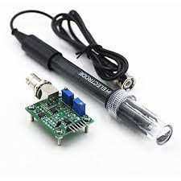
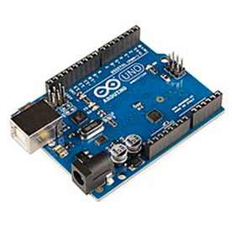
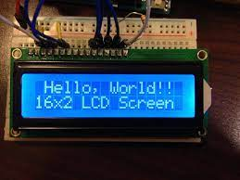
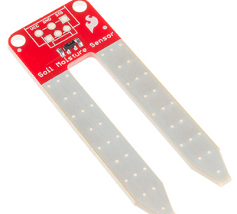
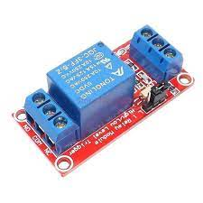
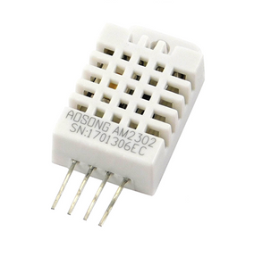
COMPONENTS USED
ARDUINO
pH SENSOR
pH Sensor measures pH of the filtered waste water and sends data to microcontroller.
Its work is to Coordinate all the
activities of smart irrigation system.
It receives values from the Sensors and
Implements accordingly.
LCD DISPLAY
SOIL MOISTURE SENSOR
Moisture,Temperature,Humidity and pH are displayed on the LCD.
The soil moisture sensor measures
the amount of water in the soil and sends
it to the microcontroller.
RELAY MODULE
TEMPERATURE & HUMIDITY SENSOR (DHT22)
It act as switch for opening / closing the Solenoidal Valve.
This sensor measures
Temperature and Humidity around the field and sends it to the microcontroller.

Slide 6
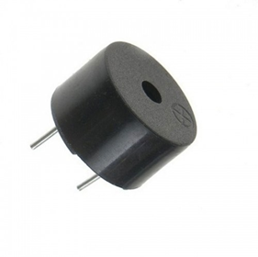
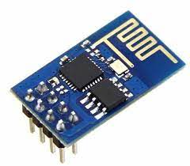
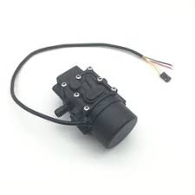

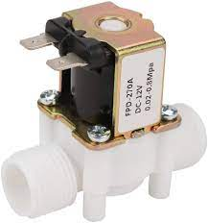
COMPONENTS USED
WIFI MODULE
BUZZER
It is used to collect data from the sensors and send it to the database for further processing.
It gives an audio signal when water flow will start.
MINI WATER PUMP
FILTER PAPER
Small Size Pump motor for circulating water.
It removes Minute Solid particles upto size greater than 20-25um.
SOLENOIDAL VALVE
Used to control the flow of water.

Slide 7
Soil moisture sensor implanted in the field measures the moisture content of the field and then accordingly send signal to the Arduino.
Arduino board then processes the input from soil moisture sensor and give output signal to the water pump to send treated waste water onto the field.
When moisture level of the soil will reach up to the desired level, soil moisture sensor sends back signal to Arduino to stop the water pump.

Slide 8
NAITIK MISHRA(L) ECE II YEAR
Btech
MEMBERS
KRATIK AGRAWAL ECE II YEAR
Btech
DURGESH SATYACHANDRA ECE II YEAR
Btech
ANISH BHARDWAJ ECE II YEAR
Btech
AKSHAT SRIVASTAVA ECE II YEAR
Btech
SAKSHI EKKA CSE I YEAR
Btech
Team Mentor Name - Mr Santosh Mahto
Category - Academics Expertise- Electronics and communication Domain-10 yrs

